Slide 1
Electronically Transmitted Postal Ballot System (ETPBS)

Slide 2
Amendment to the Conduct of Elections Rules, 1961 regarding e-Postal Ballot Papers for Service Electors (ECI instruction No. 52/ECI/LET/FUNC/JUD/SDR/2015 dated 10th November, 2016)
The postal ballot paper may be transmitted by the Returning Officer by such electronic means as may be specified by the Election Commission of India for the persons specified in sub-clause (ii) of clause (a) of rule 18 of the Conduct of Elections Rules, 1961 ;
Where a postal ballot paper is transmitted electronically, the provisions of this rule and rules 22, 24 and 27 shall, mutatis mutandis, apply.

Slide 3
Time limit for transmission of postal ballots and connected papers through ETPBS [52/LET/ECI/FUNC/JUD/SDR/2018-Vol.II dt. 09.08.2018]
Returning Officers shall ensure that uploading of postal ballot papers and the connected papers for service voters on the ETPBS shall be completed by the day following the last date for withdrawal of candidatures.
The Returning Officer shall ensure this without fail in all cases and issue a certificate to this effect.

Slide 4
Time limit for transmission of postal ballots and connected papers through ETPBS [52/LET/ECI/FUNC/JUD/SDR/2018-Vol.II dt. 09.08.2018]
The Commission has instructed the Unit level Officers through the Nodal officers of the Forces that downloading of the electronically transmitted postal ballots along with the other connected papers uploaded by the Returning Officers, should be completed latest by the eighth day after the last date for withdrawal of candidature.
Uploading the ballot paper by the day following the last date for withdrawal will leave seven days for unit officers to download all papers, to get them printed and distributed to the Service Voters.

Slide 5
Electronically Transmitted Postal Ballot System
Electronically Transmitted Postal Ballot System (ETPBS) – developed by Election Commission of India (ECI) with the help of Centre for Development of Advanced Computing (C-DAC)
The developed System is implemented inline with the existing Postal Ballot System.
Postal Ballot will be transmitted through Electronic Means to the service voters
It enables the service voters to cast their vote on an electronically received postal ballot from their preferred location, which is outside their originally assigned voting constituency.
This system would be an easier option of facilitating voting by the electors as the time constraint for dispatch of postal ballot has been addressed using this system.

Slide 6
Electronically Transmitted Postal Ballot System
Class of electors who would be eligible for Electronically Transmitted Postal Ballot System
Service Voters,
other than those who opt for proxy voting
(Classified Service Voters)
The wives of service voters

Slide 7
Electronically Transmitted Postal Ballot System - Eligibility
Elaboration of the Entitlements
“Service Voter” means any person mentioned in section 20(8) of the RP Act 1950 and clause (a) of Section 60 of the Representation of the People Act, 1951 i.e.
members of the armed forces of the Union,
members of a force to which the provisions of Army Act, 1950 (46 of 1950) have been made applicable whether with or without modifications
members of an armed police force of a State who are serving outside that State, and
persons who are employed under the Government of India in a post outside India (e.g. Ambassadors of India abroad, their staff etc.). Their names are registered in the last part of the electoral roll. Service voters who have opted for proxy voting are called Classified Service Voters.
The wife of a service voter who ordinarily resides with him is also given the same facility of Postal Ballot as to the service voters.
However it is clarified –
Under sub-section (6) of Section 20 of the Representation of the People Act, 1950, the word “wife” means wife and should not be taken to include the husband of a lady service voter.

Slide 8
Electronically Transmitted Postal Ballot System
Contents of Electronically Transmitted Postal Ballot System
Electronically Transmitted Postal Ballot System for entitled voters shall be uniform across all categories.
It shall be transmitted in electronic data format to the entitled voter on a real-time basis.
The process of delivery shall incorporate a mechanism to authenticate the voter using electronic means.
The Postal Ballot transmission shall include the following documents in a single electronic transmission.
List of Content Page
Postal Ballot Paper
Form 13-A - Declaration by Elector
Form 13-B - Cover A (Inner Envelope)
FORM 13-C - Cover B (Outer Envelope)
Form 13-D - Instructions for the Guidance of Elector

Slide 9
Electronically Transmitted Postal Ballot System
Issue of Postal Ballot by Returning Officer
The Returning Officer will login to the system by entering his credentials and thereby authenticating himself by providing the OTP received on his registered mobile number.
Postal Ballot shall be prepared by the RO for his constituency and uploaded using the Electronically Transmitted Postal Ballot System.
It shall be transmitted in electronic data format to the entitled voter of the particular constituency on a real-time basis.
The Returning Officer will be generating the PIN and the password protected Electronically Transmitted Postal Ballot for the Service Voters associated to his constituency.
This service voter electoral roll data having association between the Service Voters, Unit Offices and Record Offices will be utilized for the Electronic Transmission Of The Postal Ballot to the Service Voters.

Slide 10
Electronically Transmitted Postal Ballot System
Issue of Postal Ballot by Returning Officer
Returning Officers shall ensure that uploading of postal ballot papers and the connected papers for service voters on the ETPBS shall be completed by the day following the last date for withdrawal of candidatures.
The Returning Officers shall ensure this without fail in all cases and issue a certificate to this effect.
Downloading of Postal Ballot by Unit Officer
Downloading of the electronically transmitted postal ballots by the Unit Officer along with the other connected papers uploaded by the Returning Officers, should be completed latest by the eighth day after the last date for withdrawal of candidature.

Slide 11
Electronically Transmitted Postal Ballot System – Download: Service Voter
“Download of Postal Ballot” and “Transmitting of Password” for the Service Voter
The Designated Officer will login to the system by entering his credentials and thereby authenticating himself by providing the OTP received on his registered mobile number.
The Unit Officer will be able to download the Postal Ballots on behalf of all the associated service voters, in bulk. These downloaded ballots will be password protected.
The downloaded Postal Ballot can now be e-transmitted/hand-delivered using their secured network/infrastructure to the individual service voters.
The PIN will be transmitted/dispatched to the individual service voters by the Record Officer to ensure that the downloaded Postal Ballot is opened by the concerned service voter only.
Multimedia based training packages related to the functioning and usage of the Postal Ballots is provided to the voters well before the announcement of the elections.

Slide 12
Electronically Transmitted Postal Ballot System – Download: Service Voter
Returning Officer
Generate PIN
Generate password protected ETPB
Record Officer
PIN will be e-transmitted/dispatched to the individual Service Voters using their secure network/infrastructure
Unit Officer
Download the Postal Ballots on behalf of all the associated Service Voters, in bulk. These downloaded ballots will be password protected
e-transmit/hand deliver to the concerned service voter associated with him

Slide 13
Electronically Transmitted Postal Ballot System – Download: Service Voter
Marking of Vote and dispatch of marked Postal Ballot by Service Voter
The Service Voter will:
Mark Vote on printed Postal Ballot Paper
Sign the Form “Declaration by the Elector”
Place the Vote (Marked Postal Ballot Paper) in Envelope-A and seal it
Place the declaration form and Envelope-A in Envelope-B and seal it
Post/Dispatch this Envelope-B to the respective RO

Slide 14
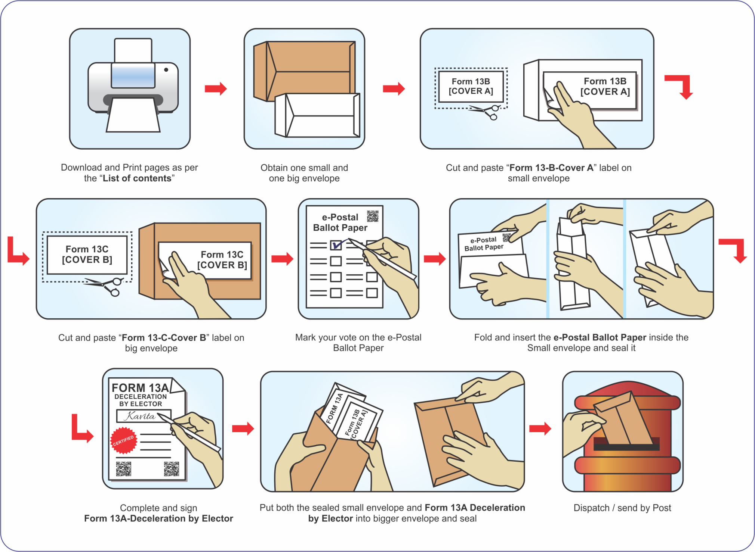
INFOGRAPHIC - Process to be followed by Service Voter

Slide 15
Electronically Transmitted Postal Ballot System – Pre Counting
The pre counting process involves the verification of the following:
Form 13-C - Cover B (Outer Envelope)
Form 13-A - Declaration by Elector
Form 13-B - Cover A (Inner Envelope)
Postal Ballot Paper
Optically machine readable code will be scanned on the Outer Envelope and necessary validity checks will be performed.
After verification of the outer envelope, a unique serial number will be recorded in the database against the code on outer envelope (Cover B) and the same will be written on the Cover B.
If another envelope with the same credentials/serial number is found, then the serial number of the older envelope will be displayed to the RO for duplicate envelopes.
This will help in locating the duplicate envelopes physically.

Slide 16
Electronically Transmitted Postal Ballot System – Pre Counting
On opening the outer envelope, two documents are required to be found inside.
The declaration by the voter and
Inner envelope containing the Postal Ballot Paper.
As each cover is opened, RO will take out the declaration and the inner envelope, scan, verify and then scrutinize the declaration.
Before opening the inner envelope containing the marked postal ballot paper, the Returning Officer will check the declaration.
Thereafter the inner envelope will be verified and opened one after another. Then the marked Postal Paper will be taken out, verified and validity of the Postal Ballot Papers scrutinized and decisions arrived at.
The valid Postal Ballot Paper will then be forwarded for COUNTING.

Slide 17
Electronically Transmitted Postal Ballot System – Pre Counting
Pre-Counting
Scan
Form 13-C
(Outer Envelope)
Scan
Form 13-A
(Declaration)
Scan
Form 13-B
(Inner Envelope)

Slide 18
Electronically Transmitted Postal Ballot System – Pre Counting
Pre-Counting
Scan Vote (Marked Postal Ballot)
Forward Valid Votes for Counting

Slide 19
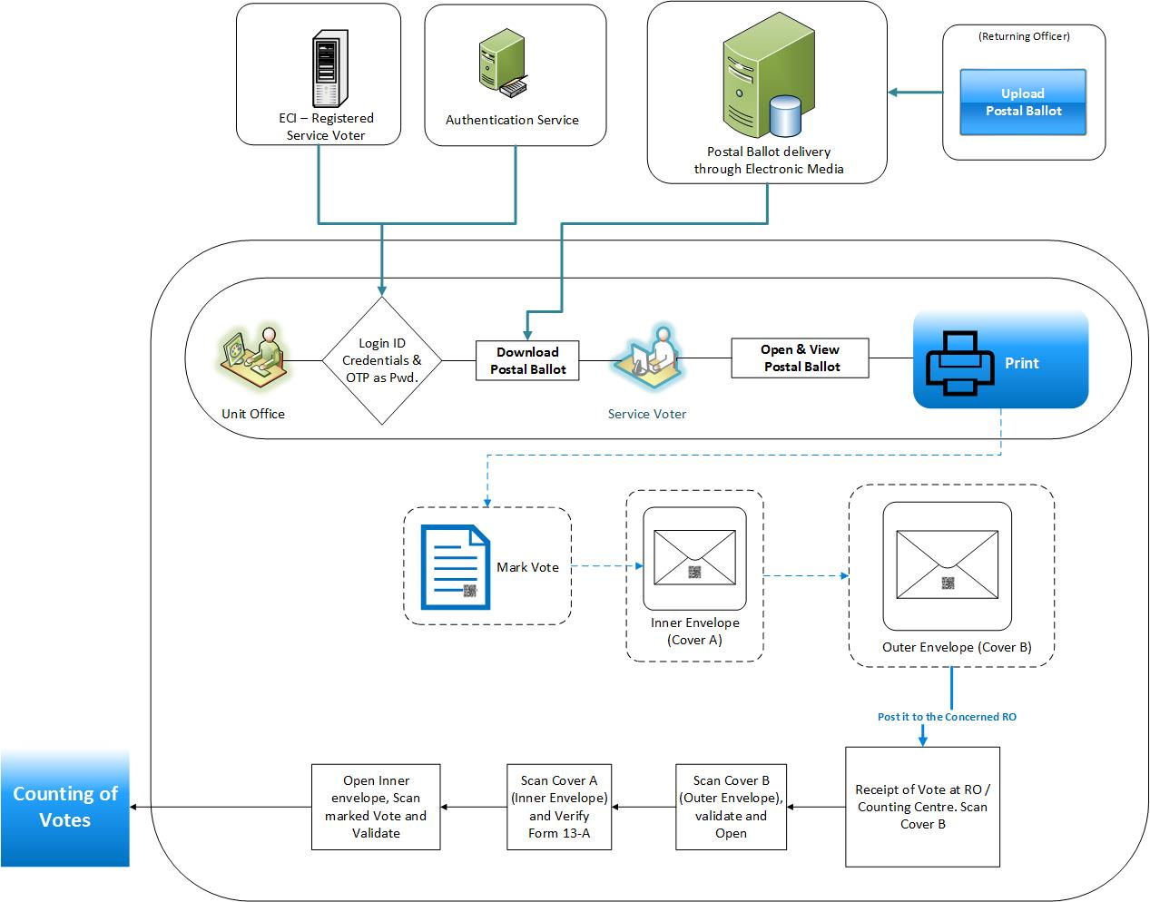
Flow of the Electronically Transmitted Postal Ballot System: Service Voter

Slide 20
Electronically Transmitted Postal Ballot System
On the announcement of the elections, the verified Returning Officer’s login credentials, address, mobile no. and other relevant details should be updated in the system.
RO should be provided the dashboard to check the details & rectify the errors, if any.
RO should not be able to update the RO credentials & his mobile number, if any discrepancy is noticed. He should be able to only report this to the concerned authorities, so that the necessary action can be initiated.

Slide 21
Electronically Transmitted Postal Ballot System
RO should ensure that the Standard Operating Procedure (SOP) for the scanning of the QR code of the received votes should be adhered to.
RO should ensure to mark the Serial Numbers as prompted by the ETPBS, so as to easily identify the multiple/duplicate received envelopes/declaration/votes.
RO should use the particular scanning equipment - QR Code scanners, as mentioned in the SOP. This will help ensure the reliability/ trustworthiness of the scanning results.

Slide 22
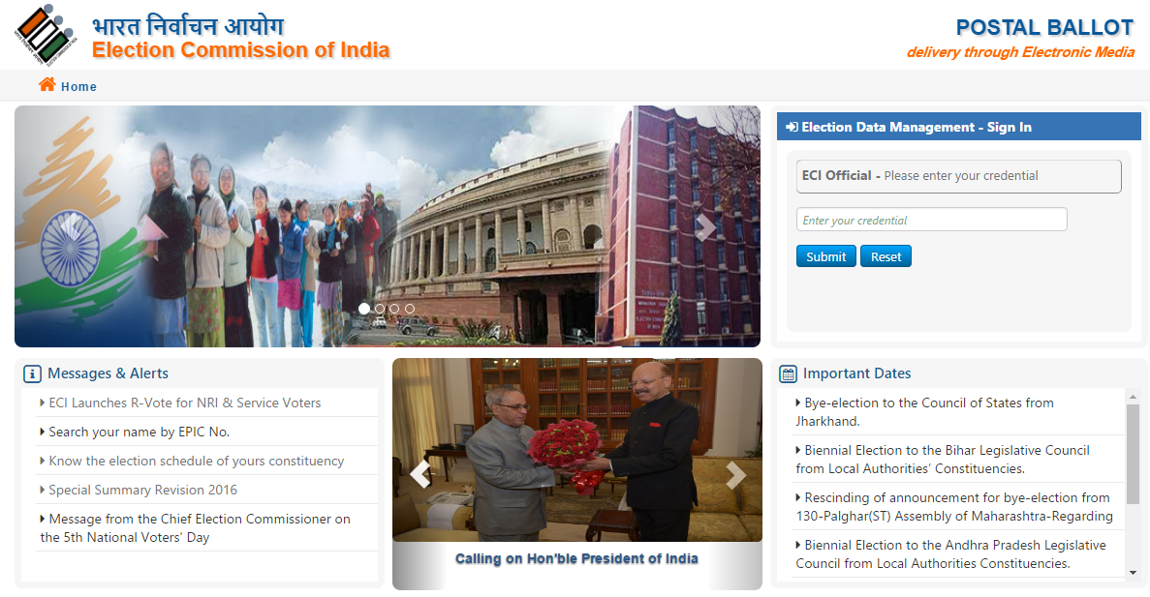
Login Screen for the Central Admin Officer (CAdmin)

Slide 23
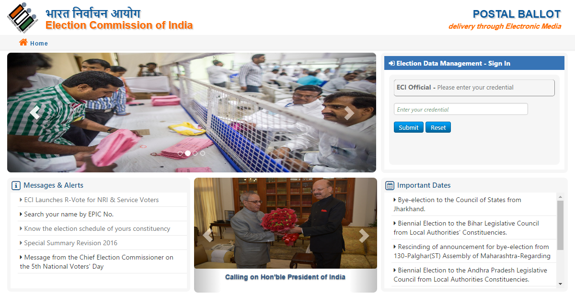
Login Screen for the Returning Officer (RO)

Slide 24
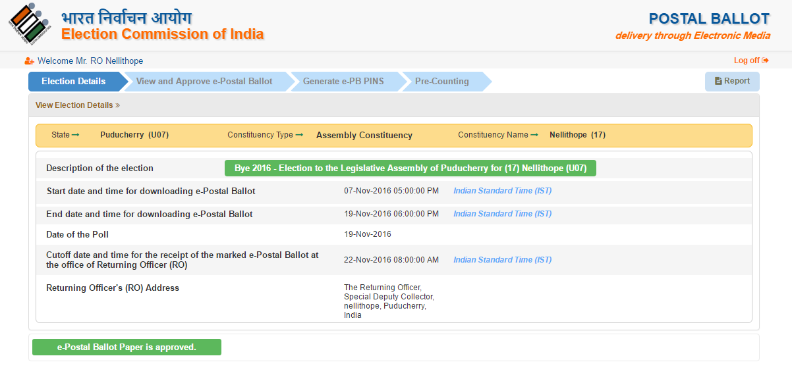
Election Details Screen for the Returning Officer (RO)

Slide 25
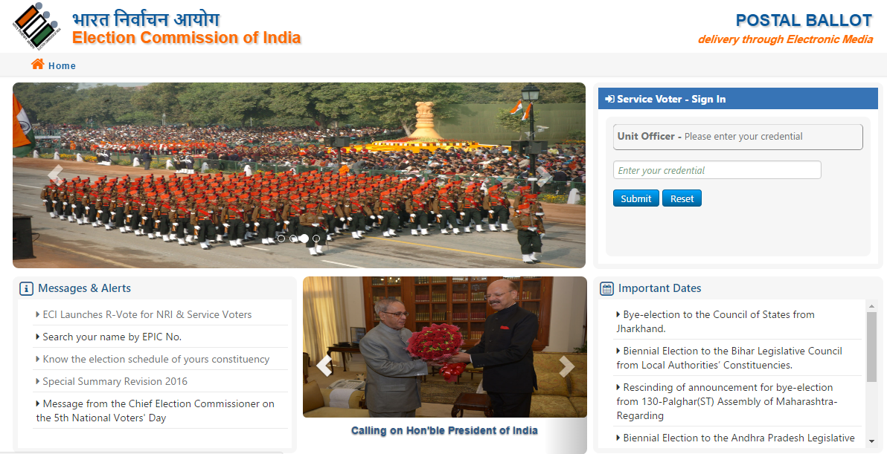
Login Screen for the Record Office/Unit Office/Commander

Slide 26
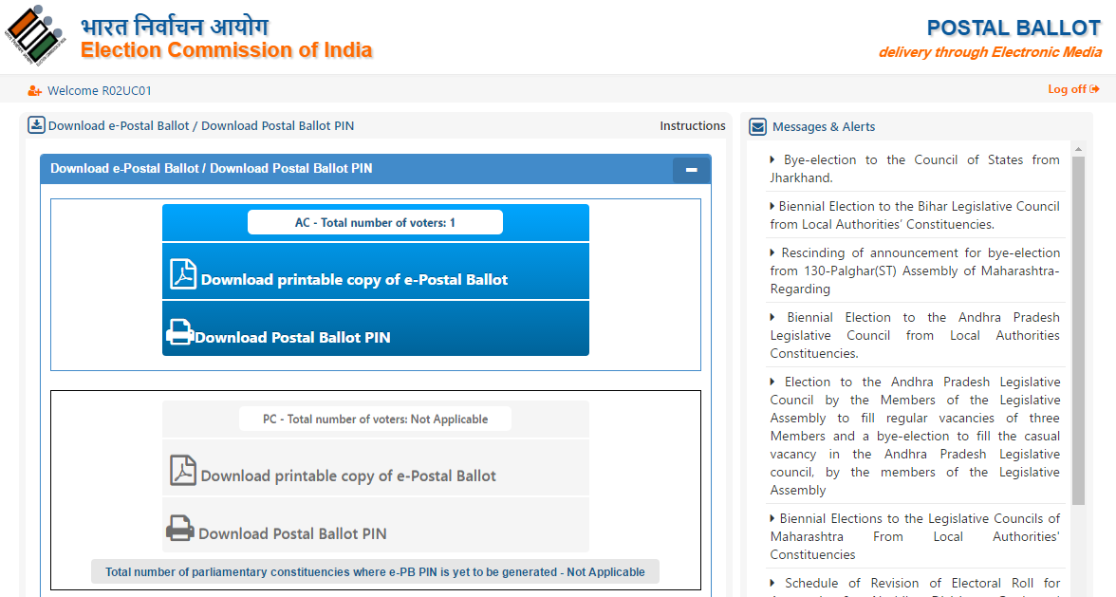
Download of the Postal Ballot by the Record Office/Unit Office

Slide 27
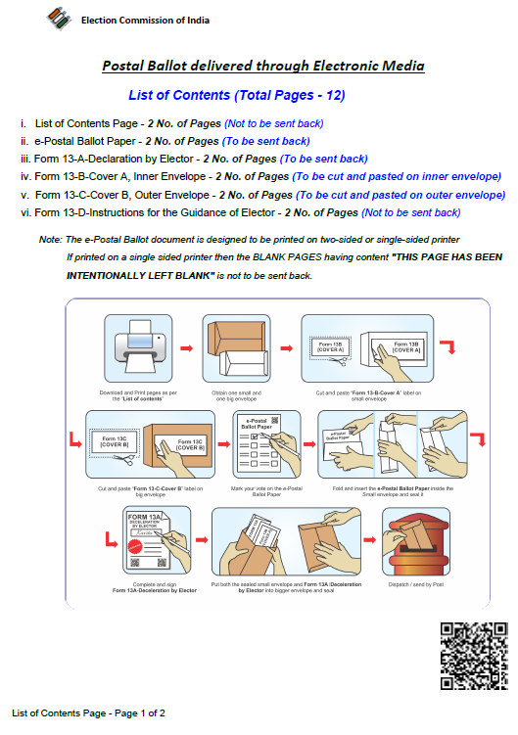
View of the downloaded Electronically Transmitted Postal Ballot

Slide 28
Thank You

